Slide 1
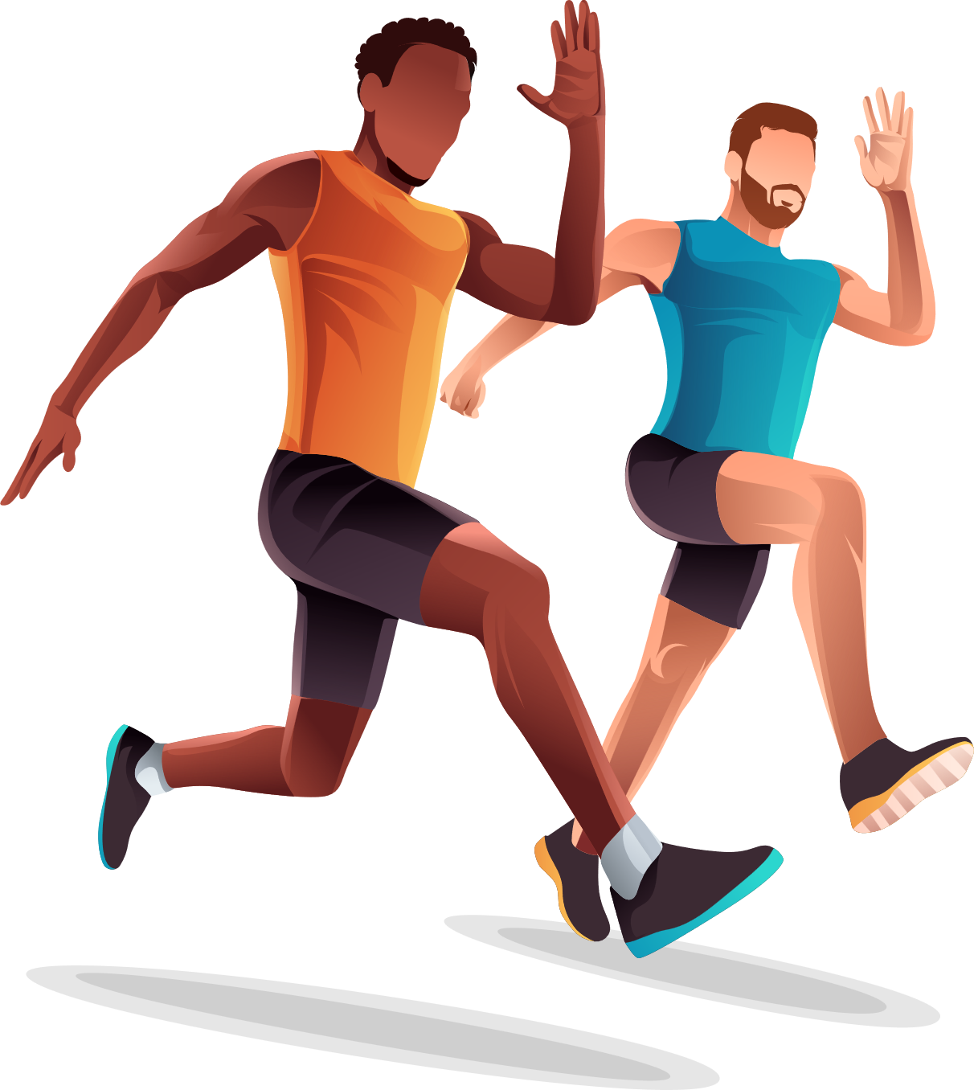



Sport Injustice
Olympics History as an example
Presented by – Group 15:
Swapnil Deore​
Somia Abdelrehman

Slide 2
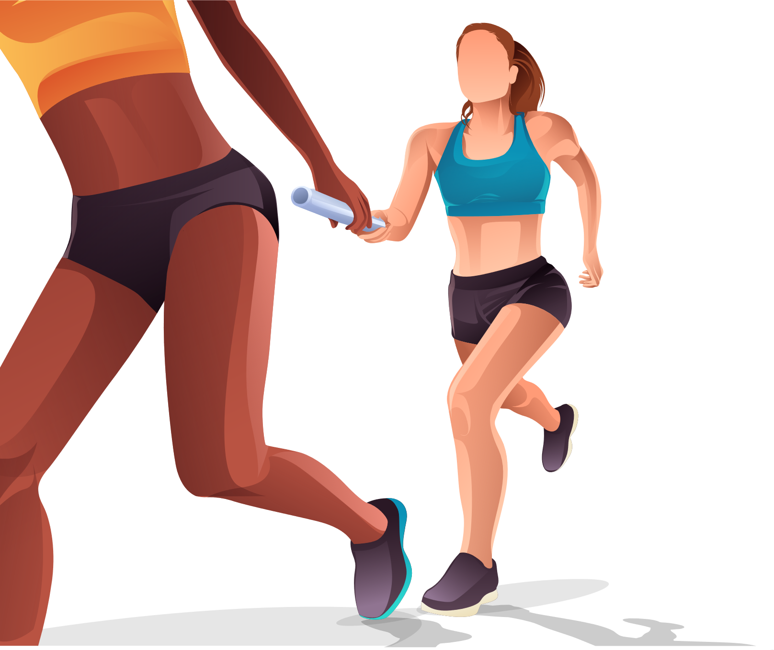
Objectives
Exploratory Analysis on Olympics data to
Explore trends in sport and examine the complex connections between sport, economics and gender.
This analysis is expected to help us identify biases and inequality in sport through Olympics history​

Slide 3
Background
Olympic Games
“The modern Olympic Games or Olympics are the leading international sporting events featuring
summer and winter sports competitions in which thousands of athletes from around the world
participate in a variety of competitions. The Olympic Games are considered the world's foremost
sports competition with more than 200 teams, representing sovereign states and territories.” [1]
Gross Domestic Product(GDP) per capita
“GDP per capita is an important indicator of economic performance and a useful unit to make cross-country comparisons of average living standards and economic wellbeing.” [2]

Slide 4
Exploratory Questions

Slide 5
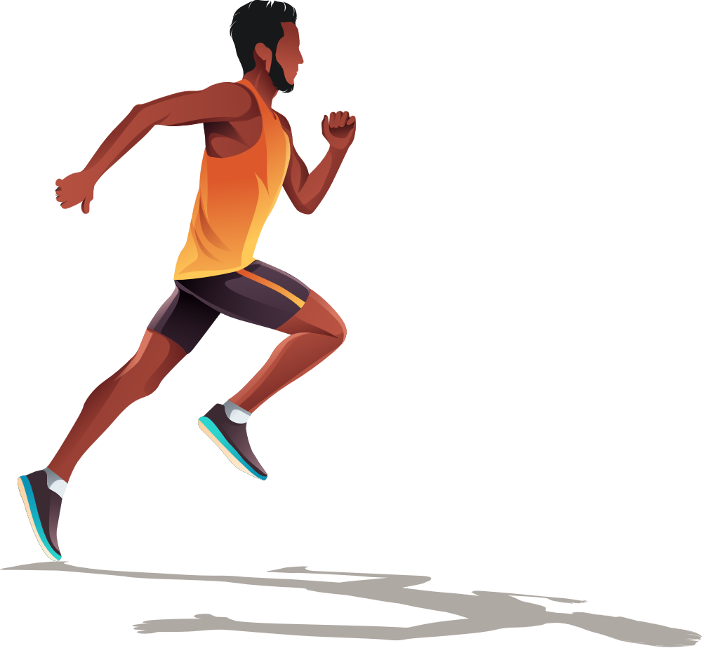
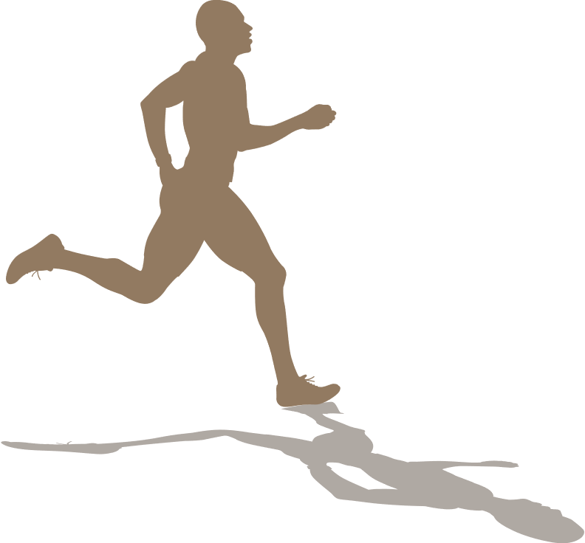
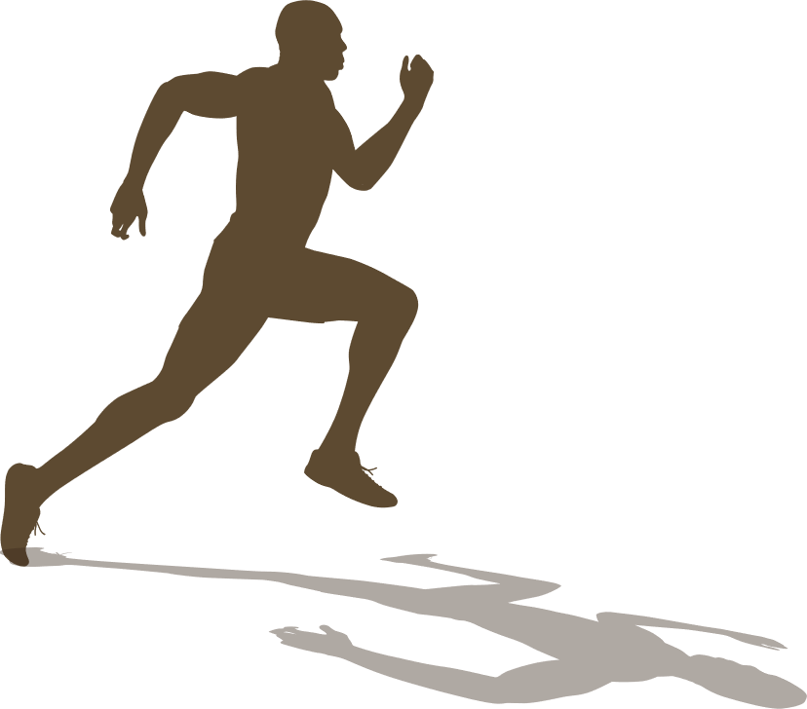
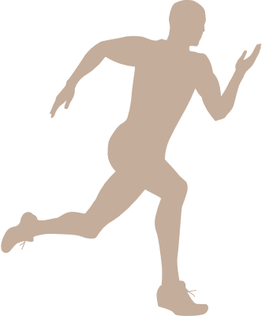
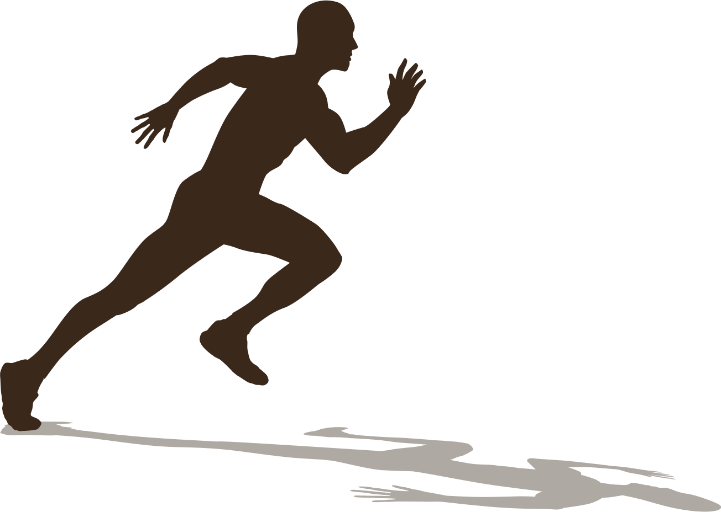

01
What is the recent percentage of women athletes in the Olympics and how did it change over time?
Unit: Percentage/year
02
What countries have the highest female representation and what countries are the lowest?
Unit: Female athlete per country

Slide 6
03
What are the top five countries in terms of No of medals achieved throughout the Olympics history and what is the percentage of female representation in these teams?​
Unit(s): Medal/country
04
Does country GDP influence the number of medals achieved? Is there any correlation between the two?​
Unit(s): $/country, Medal/country

Slide 7
Data Sources
120 Years of Olympic History
Source: https://www.mavenanalytics.io/data-playground?page=3&pageSize=5-
Country’s demographic and economic metrics such as Population, Gross Domestic Product(GDP
Source: World bank website using their API
Source:https://data.worldbank.org/
Structured Data in CSV file
Semi-Structured Data (XML,JSON) retrieved using API

Slide 8
Methodology
Analysis
Data Cleaning
Aggregate tables using sum(), value_counts(), etc to answer the research questions
Check for null values/
Data in right format/
Remove unnecessary columns
Merging two datasets
Merge the Olympics dataset with the economic metrics dataset
Finish
Visualization and outputs
Use seaborn package for visualization

Slide 9
Demo: Jupyter NoteBook

Slide 10
Conclusion

Slide 11
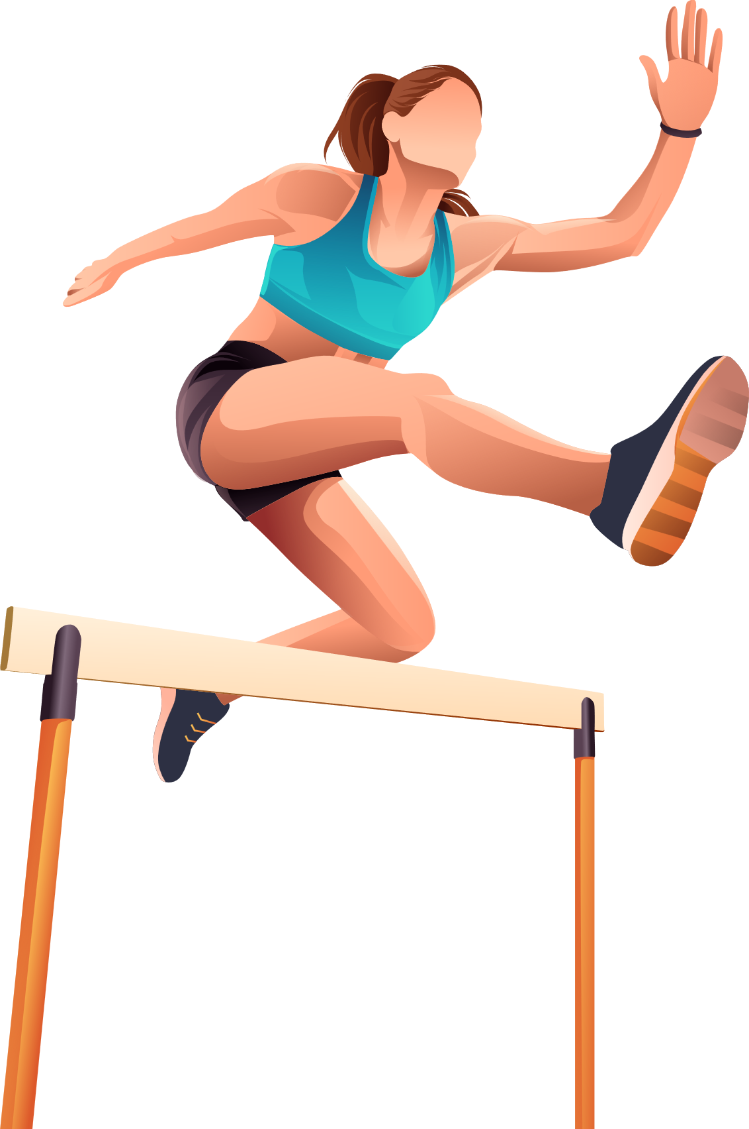
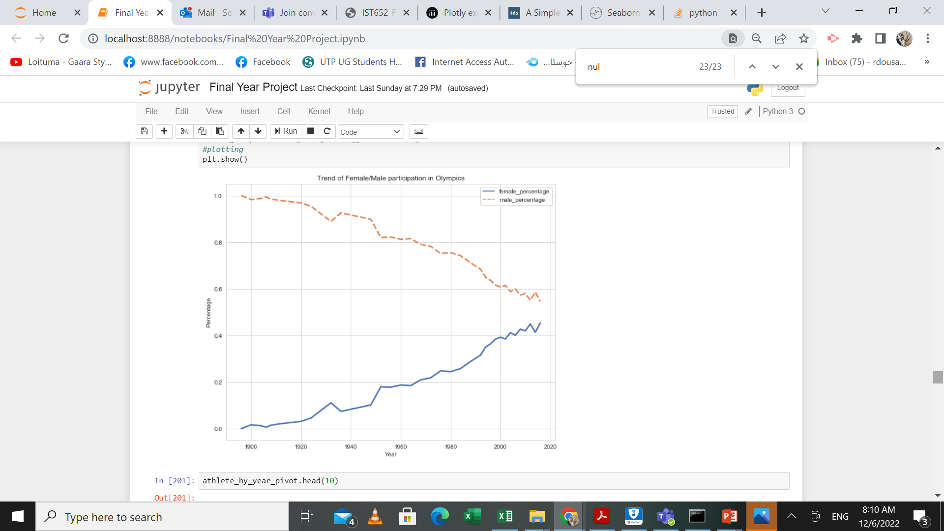
Female Participation
EDIT SLIDE SUBTITLE HERE
Female presence in Olympics has been increasing over the years.

Slide 12
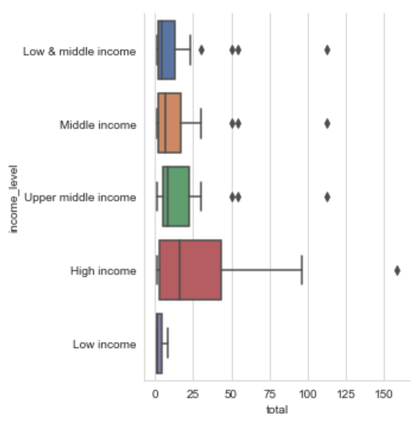
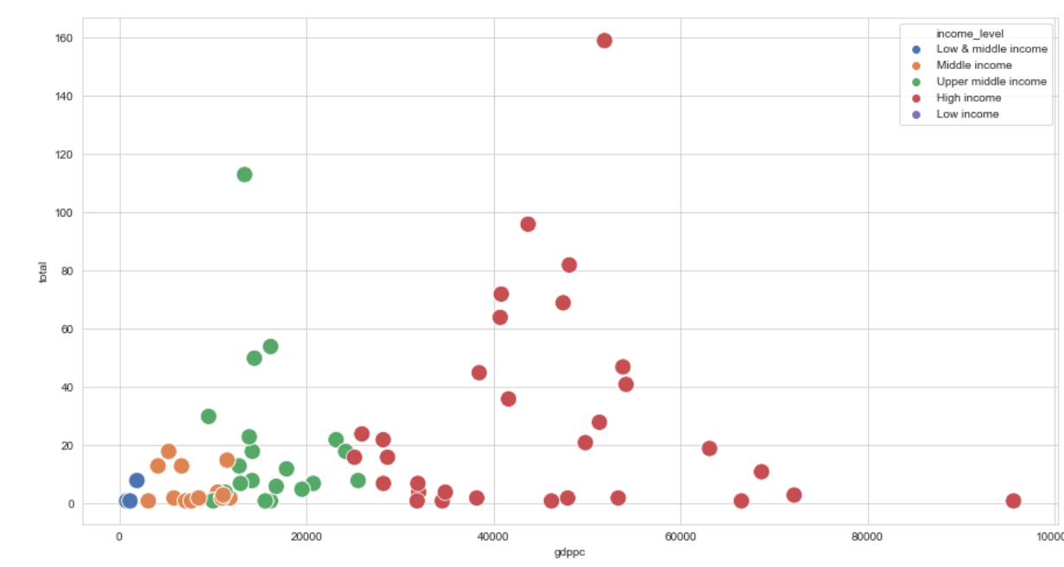
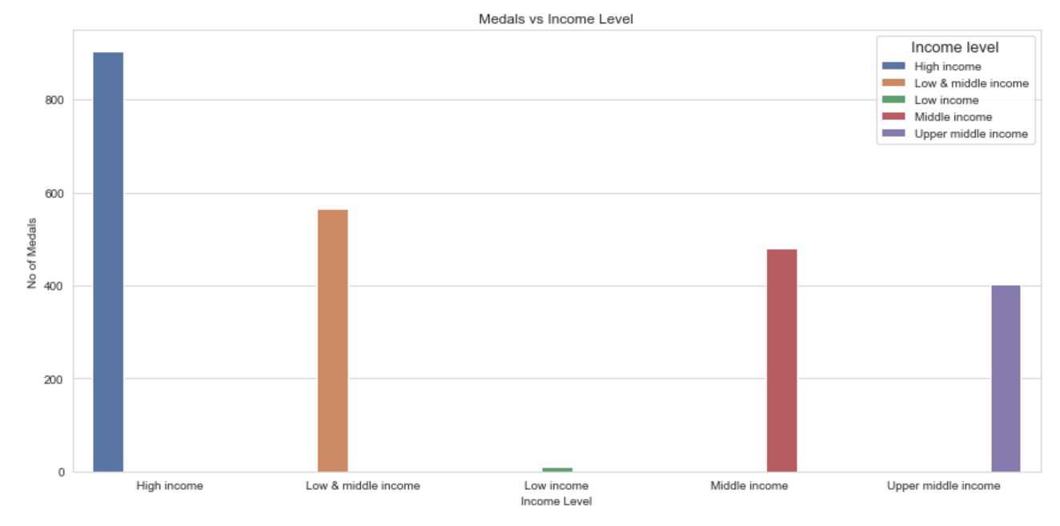
Economic Influence
There is a correlation between economic standing and number of medals achieved
High income courtiers achieved more medals
More funds to enhance the sport infrastructure in Low income countries

Slide 13
Questions and Answers

Slide 14
THANK YOU
Group 15

